Slide 1
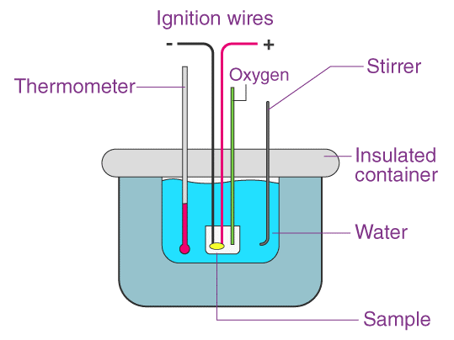
“To determine the specific heat of a liquid by the method of cooling”

Slide 2
Presented By
Name | ID
1. Md. Tawfiqul Islam Tamal | 23-52978-3
2. Md. Jarifur Rahman | 23-55463-3
3. Aftabul Kanzan | 23-55305-3
4. Dipro | 23-50440-1
5. Samiul Alim Siam | 23-55309-3

Slide 3
Table of Contents
01
02
03
04
Theory
05
Analysis and Calculation
Apparatus
06
Result
Procedure
07
Discussion
Experimental Data
08
Resources
Notes:
Here is our table of contents of our presentation

Slide 4
01
Theory

Slide 5
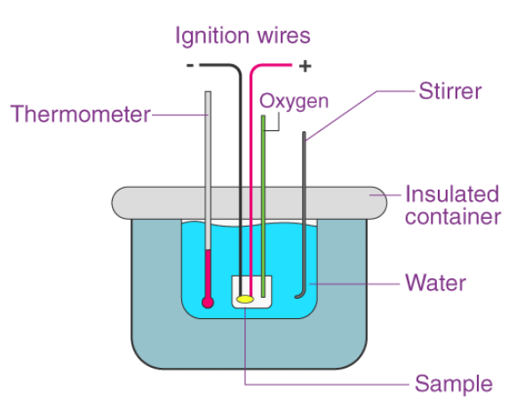
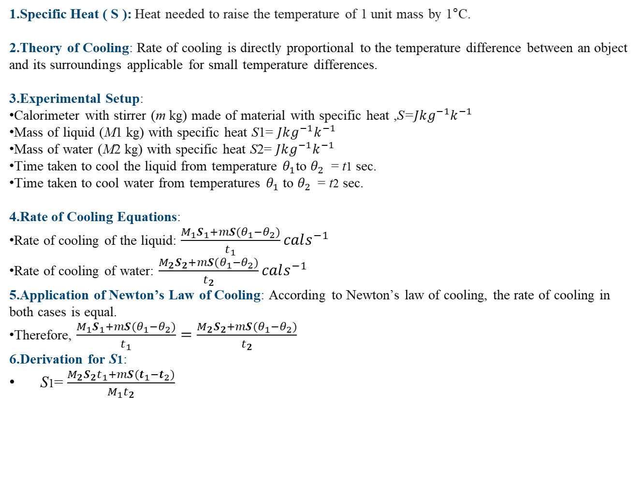
1.Specific Heat ( S ): Heat needed to raise the temperature of 1 unit mass by 1°C.
2.Theory of Cooling: Rate of cooling is directly proportional to the temperature difference between an object and its surroundings applicable for small temperature differences.
3.Experimental Setup:
Calorimeter with stirrer (m kg) made of material with specific heat ,S=$Jkg^{−1}k^{−1}$
Mass of liquid (M1​ kg) with specific heat S1​= $Jkg^{−1}k^{−1}$
Mass of water (M2​ kg) with specific heat S2​= $Jkg^{−1}k^{−1}$
Time taken to cool the liquid from temperature $θ_{1}$to $θ_{2}$​ = t1​ sec.
Time taken to cool water from temperatures $θ_{1}$to $θ_{2}$​ = t2​ sec.
4.Rate of Cooling Equations:
Rate of cooling of the liquid: $\frac{M_{1}S_{1}+mS(θ_{1}−θ_{2})}{t_{1}}cals^{−1}$
Rate of cooling of water: $\frac{M_{2}S_{2}+mS(θ_{1}−θ_{2})}{t_{2}}cals^{−1}$
5.Application of Newton’s Law of Cooling: According to Newton’s law of cooling, the rate of cooling in both cases is equal.
Therefore, $\frac{M_{1}S_{1}+mS(θ_{1}−θ_{2})}{t_{1}}=$ $\frac{M_{2}S_{2}+mS(θ_{1}−θ_{2})}{t_{2}}$
6.Derivation for S1​:
S1= $\frac{M_{2}S_{2}\text{​}t_{1}+mS(t_{1}−t_{2})}{M_{1}t_{2}}$
Notes:
Here in the theory part the starting with ohms law
For unknown resistance Rx tools are
For series resistance the formula is Rs = R1 + R2 + ... + RN
For series resistance Insight Total resistance in series is the sum of individual resistances.
5th is illustrations here is the diagrams for two resistors

Slide 6
02
Apparatus

Slide 7
A calorimeter with a stirrer,
A chamber having two walls,
A sensitive thermometer,
Balance,
Burner,
Stop-watch
$20K
10%
45K

Slide 8
03
Procedure

Slide 9
Weighing the dry calorimeter with stirrer (m).
Pouring heated water into the calorimeter up to a mark.
Recording temperature as it cools at 1°C intervals.
Taking 20-25 temperature readings.
Weighing the calorimeter with water to find water weight (M2 - m).
Cleaning and drying the calorimeter.
Pouring heated experimental liquid into the calorimeter.
Placing calorimeter with liquid inside the chamber.

Slide 10
4
Experimental Data
Notes:
Thank you Jarifur Rahman for giving me opportunity to explain the next part of our presentation which is experimental data.

Slide 11
No. of observation | Time(min) | Temperature(°C)
 |  | Water | Liquid
1 | 0 | 75 | 75
2 | 1 | 73 | 74
3 | 2 | 72 | 73
4 | 3 | 71 | 72
5 | 4 | 70 | 70
6 | 5 | 69 | 69
7 | 6 | 68 | 67
8 | 7 | 67 | 66
9 | 8 | 66 | 64
10 | 9 | 65 | 62
11 | 10 | 64 | 60
Notes:
In the slide we can see that we measured the temperature for water and liquid . We measured the temperature within 45 min.
For obs no. 1 . Time taken is o the water temp is 75 and liquid temp is also 75
For obs no. 11 . Time taken is 10 the water temp is 64 and liquid temp is also 60

Slide 12
No. of observation | Time(min) | Temperature(°C)
 |  | Water | Liquid
12 | 12 | 63 | 60
13 | 14 | 62 | 58
14 | 16 | 60 | 56
15 | 18 | 59 | 55
16 | 20 | 58 | 53
17 | 22 | 57 | 52
18 | 24 | 55.5 | 50
19 | 26 | 54.5 | 49
20 | 28 | 53.5 | 48
21 | 30 | 53 | 47
22 | 33 | 51 | 46
23 | 36 | 50 | 44
24 | 39 | 49 | 43
25 | 42 | 48 | 42
26 | 45 | 47 | 41
Notes:
After 45 min later the water temp is 47 and liquid temp is 41

Slide 13
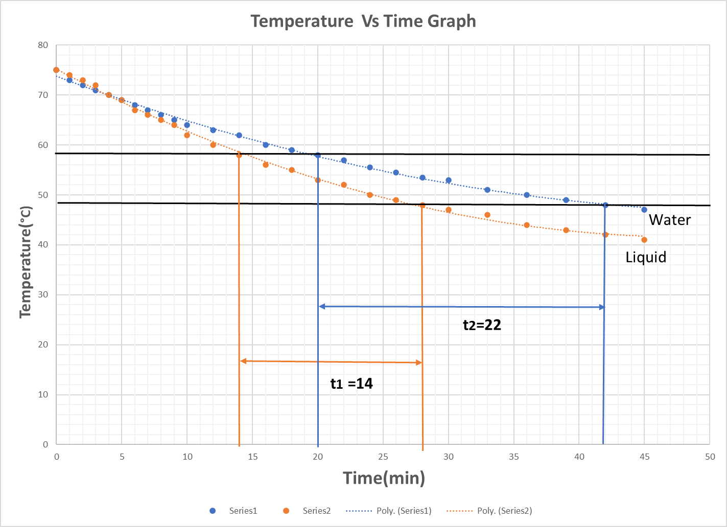
Notes:
In the next slide we can see that here is a graph temperature VS time in the x axis we take time in min and in the y axis we take temperature in degree Celsius
the blue curve is for water and the orange curve is for liquid
Here t1 is Time taken to cool the liquid from temperature
And t2 is Time taken to cool the water from temperature
That’s all from side now I would like to request my group member Samiul Alim Siam to complete the next part of our presentation

Slide 14
5
Analysis and Calculation

Slide 15
i. Mass of the calorimeter + stirrer, m= 78.7 grams
ii. Specific heat of the material of the calorimeter, s = 0.0909 cal·g-1 ·℃-1
iii. Mass of calorimeter + stirrer + water, 𝑚2 = 163.1 grams
iv. Mass of water, 𝑀2 = 𝑚2 − 𝑚 = 84.4 grams
v. Mass of calorimeter + stirrer + liquid, 𝑚1 = 161.7 grams

Slide 16
vi. Mass of experimental liquid, 𝑀1 = 𝑚1 − 𝑚 = 83 grams
vii. Time taken to cool by the liquid, t1=720 sec
viii. Time taken to cool by the water, t2 = 1200 sec
ix. Specific heat of water, 𝑆2= 1 cal/g-℃

Slide 17
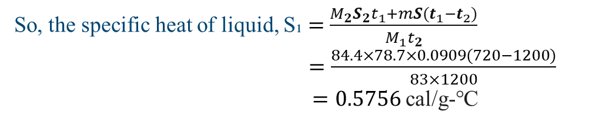
So, the specific heat of liquid, S₁ $=$ $\frac{M_{2}S_{2}\text{​}t_{1}+mS(t_{1}−t_{2})}{M_{1}t_{2}}$
$=$ $\frac{84.4×78.7×0.0909(720−1200)}{83×1200}$
$=0.5756$cal/g-℃

Slide 18
06
Result

Slide 19
The specific heat of liquid is 0.5756 cal/g-℃

Slide 20
7
Discussion

Slide 21
The volume of the liquid in the calorimeter were the same.
The outer surface of the calorimeter must remain the same so that liquids were heated outside the calorimeter.
The experiment was started in a fix Suren own surrounding.
The calorimeter was made of good condition material so didn't face any problem measuring the temperature.
The thermometers were in good condition as well so finished the experiment swiftly.
$20K
10%
45K

Slide 22
8
Resources

Slide 23
Fundamental of Physics
Wikipedia Resources
Khan Academy Physics ( You Tube )
Academic Lecture Materials

Slide 24
Thank You
Day 1
Day 3

